Slide 1
Architecture-based Reliability Analysis of Web Services in Multilayer Environment
M. Rahmani, A. Azadmanesh, H. Siy
University of Nebraska-Omaha

Slide 2
Agenda
Introduction
Objectives
Background (Petri-net, SRN)
Our modeling approach
Experimental analysis
Preliminary results
Conclusion

Slide 3
Introduction
Architecture-based reliability analysis
Individual reliability of components
Architecture of software based on components
Web service reliability analysis
Due to the hierarchical complexity of layers, architecture-based reliability analysis of system is challenging
E.g. one of the major causes of failure in web services is resource exhaustion

Slide 4
Objectives
Reliability analysis of web services where some details of underlying layers and configuration settings are taken into account. (Main layers: Web server, Application server, Web service, and database)
Stochastic Petri Net (SPN) is used as an state-based modeling in reliability modeling

Slide 5
Objectives - Rationale
One of the main causes of failures in web applications is not logical or computational error, but rather system overload, configuration errors, and resource exhaustion [Per05] .
Many of component-based reliability approaches to service-based environment do not consider these types of failures [Gra05] [ Zho06] .
Although some authors claim that component-based reliability approaches can be applied to service-oriented computing applications, to the best of our knowledge, no solid work exists to prove this [Gra06] .

Slide 6
Objectives - Rationale
In this study, the layers are modeled as “gray boxes” or “gray layers”, where a layer constitutes an autonomous logical behavior, and yet some details of code behavior and configuration settings are taken into account.

Slide 7
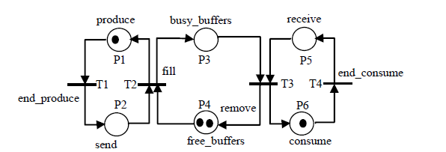
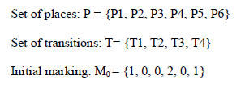
Background
Petri net modeling
A Petri net graph consists of a set of places P, a set of transitions T, and a set of arcs F.
A marked Petri net (also called Petri net) is a 4-tuple (P, T, F, M0), where (P, T, F) is a Petri net graph and M0 is the initial marking of Petri net graph.
A Petri net example

Slide 8
Background
SRNs (Stochastic Reward Nets) [Zho06] are considered in this research.
A GSPN is a 6-tuple (P, T, F, W, M0, λ).
P = {p1, p2... pk} is a finite set of places.
T is a finite set of transitions partitioned into two subsets: TI (immediate) and TD (timed) transitions, where transition t ∈ TD are associated with rate λ.
F ⊆ (P ∗ T) ∪ (T ∗ P) is a set of arcs.
M0 = {m01, m02… m0k} is an initial marking.
W: T → R is a function, which is defined on the set of transitions, where R is the set of non-negative real numbers. TD is associated with priority zero, whereas all other priority levels are reserved for immediate transitions.
SRNs are an extension of GSPNs
SRNs include all the features of GSPNs and many more such as guards, timed transition priorities, halting conditions, and reward rates [Tri93].

Slide 9
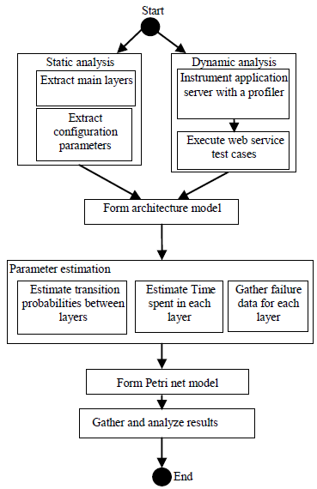
The modeling approach
The proposed approach of architecture-based software reliability

Slide 10
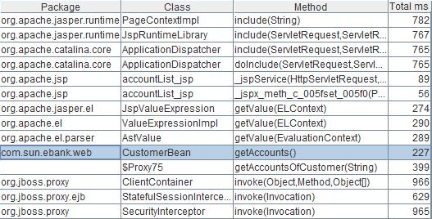
Dynamic Analysis
Instrument application server with a profiler
AppDynamics [ App] or JRAT [JRA]
Execute web service test cases
Web server
Web service
Application server

Slide 11
Static Analysis
Extract main layers
using some architectural tools such as Structure 101
Extract configuration parameters (mostly gathered from performance analysis literature)
Http thread pool in the web container,
(server.xml)
EJB instance pool in EJB container,
(standardjboss.xml)
Database connection pool of the data access layer
(hsqldb-ds.xml)

Slide 12
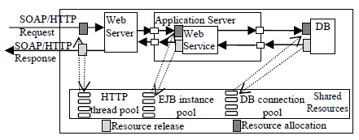
Form Architecture Model
Considering the major layers and resources extracted from the previous step, an architecture model will be built .
Architecture of JBoss, showing the interaction between layers and shared resources

Slide 13
Parameter Estimation
(the purpose of this phase is to attain the information needed to build the stochastic behavior among and within the layers)
Estimate transition probabilities between layers
Estimate time spent in each layer
Gather failure probability in each layer

Slide 14
Estimate time spent in each layer
compute time spent in each layer in JRAT output
Web server
Web service
Application server

Slide 15
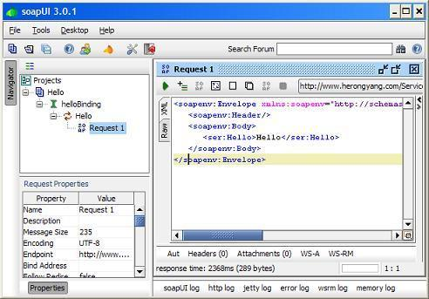
Gather failure probability in each layer
Gather failures from server.log or from other web service packages such as SOAPUI and JMeter.
Map each failure to the layer in which the failure has occurred

Slide 16
SRN (Stochastic Reward Net)
Timed activities, Transition rates, failure probability of each layer, and configuration parameters are determined
Web container
Start Application Server
Start
Rest of model
Fail
Http Thread pool

Slide 17
Modeling tool: Mobius [Mob]
Reasons for adopting Mobius:
Mobius is built with SRN in mind, so asynchronous behavior can be described concisely.
Provides graphical user interface.
Provides various distribution models (exponential,etc.)
Provides a hierarchical modeling, similar to software modularization.

Slide 18
Gather and Analyze Results
The final phase of this approach is to run the Petri net model, collect, and analyze the results .

Slide 19
Experimental analysis
The Case Study
Duke’s Bank Web service
Running on JBoss AS 4.2.2 (Default Web server: Apache Tomcat 6.0.13)
Windows Vista (Intel 2.66GHz, Memory 2G)
Web Container (Tomcat )
EJB Container
WS Client
Web service invocation
Session container
Entity container
Http11ConnectionHandler
Teller Bean
SOAP
Http
Account Controller Bean
Account Bean
Data Base (Hsqldb)
Partial view of Duke’s Bank Web Service architecture

Slide 20
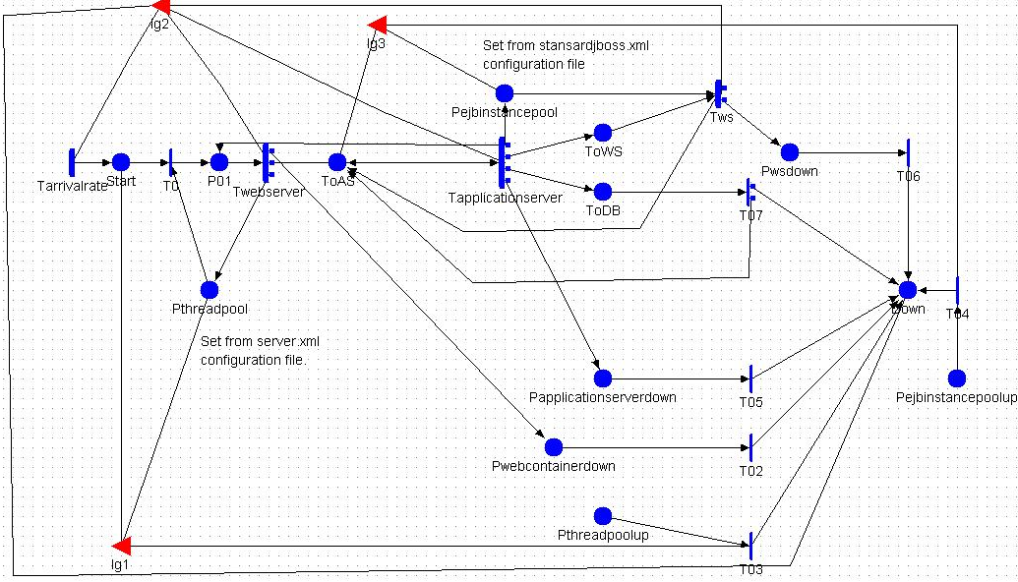
Preliminary Results
The Petri net sub-model representing the communication between web server, application server, and web service

Slide 21
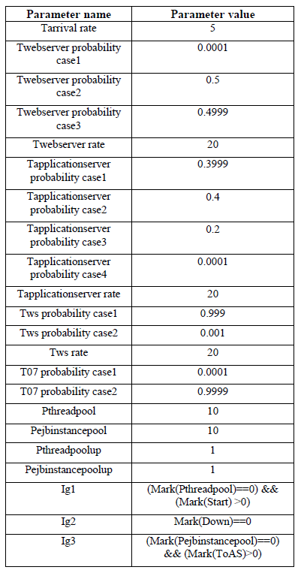
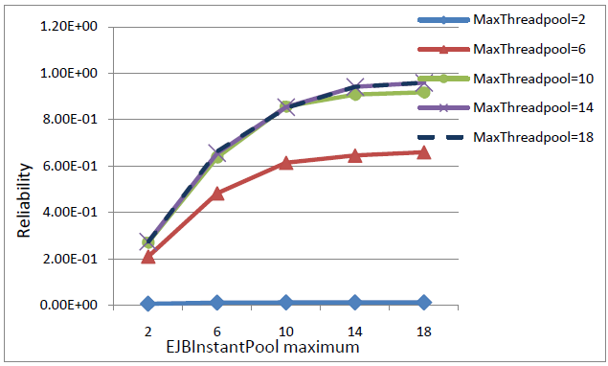
Preliminary Results
Reliability based on maximum number of threads in thread pool and maximum number of EJB in EJB pool
Parameters set for Petri net model

Slide 22
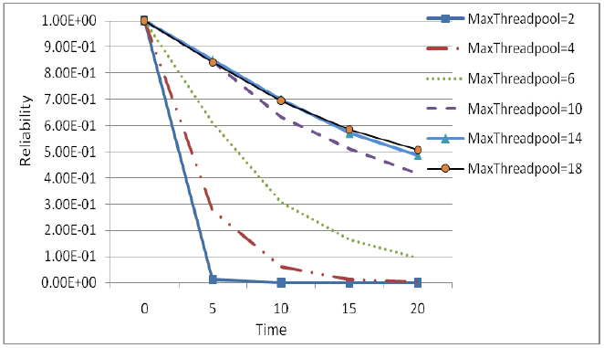
Preliminary Results
Reliability through the time based on maximum number of threads in thread pool

Slide 23
Conclusion
The service-based system is modeled using the layered architecture style.
The system is mapped to a Petri net model in order to estimate the overall reliability under various conditions and scenarios.
Although failures originated from misconfiguration is one of the common types of failures in web services, there is not much attention to these failures in architecture based software reliability approaches.

Slide 24
Conclusion
The main contribution of this research study is the reliability modeling of the entire web service system and the configuration parameters of the underlying middleware.
By including the multilayer approach and inclusion of the appropriate configuration parameters, it is expected that a more accurate reliability prediction of web service software is possible.

Slide 25
References
[App] AppDynamics, http://www.appdynamics.com/
[Erl05] T. Erl, Service-Oriented Architecture: Concepts, Technology, and Design, Prentice Hall, 2005.
[Err05] A. Erradi and P. Maheshwari, ―A Broker-based Approach for Improving Web Services Reliability, Proceedings of the IEEE International Conference on Web Services (ICWS’05).
[Gra05] V. Grassi, ―Architecture-Based Reliability Prediction for Service-Oriented Computing, Architecting Dependable Systems III, Lecture Notes in Computer Science, Vol. 3549, 2005.
[Gra06] V. Grassi, S. Patella, ―Reliability Prediction for Service-Oriented Computing Environments, IEEE Internet Computing. 10(3), May-Jun. 2006.
[Hwa08] Hwang, S., Lim, E., Lee, C., & Chen, C. (2008). ―Dynamic web service selection for reliable web service composition,‖ IEEE Transactions on Services Computing, 1(2), pp. 104-116, 2008.
[JRA] JRAT, http://jrat.sourceforge.net.
[Mar95] A. Marsan, G. Balbo, G. Conte, S. Donatelli, G. Franceschinis, Modeling with Generalized Stochastic Petri Nets, Wiley, Chichester, England, 1995.
[Mus84] J. D. Musa and K. Okumoto, ―A Logarithmic Poisson Execution Time Model for Software Reliability Measurement‖, 7Int. Conf. Software Engineering, IEEE Computer Society. New York. 1984.
[Per05] S. Pertet, P. Narasimhan, "Causes of Failure in Web Applications (CMU-PDL-05-109)" (2005). Parallel Data Laboratory.Paper 48. http://repository.cmu.edu/pdl/48.
[Tri93] K. S. Trivedi, G. Ciardo, M. Malhotra, and R. Sahner, ―Dependability and performability analysis, in Int. Symp. Computer Performance Modeling, Measurement, and Evaluation , 1993, (Tutorial) 16th IFIP WG 7.3.
[Web] Web services glossary, http://www.w3.org/TR/ws-gloss/.
[Zho06] D. Zhong and Zhichang Qi, ―A Petri Net Based Approach for Reliability Prediction of Web Services‖, OTM Workshop, LNCS 4277, pp. 116-125, 2006.

Slide 26
Thank you
&
Questions?

